Slide 1

Lecture #1
SOFT COMPUTING
INT508

Slide 2
Introduction to Neural Network
As we have noted, a glimpse into the natural world reveals that even a small child is able to do numerous tasks at once.
The example of a child walking, probably the first time that child sees an obstacle, he/she may not know what to do.
But afterward, whenever he/she meets obstacles, she simply takes another route.
It is natural for people to both appreciate the observations and learn from them.
An intensive study by people coming from multidisciplinary fields marked the evolution of what we call the artificial neural network (ANN).

Slide 3
ANNs- How They Operate
ANNs represent a highly connected network of neurons - the basic processing unit
They operate in a highly parallel manner.
Each neuron does some amount of information processing.
It derives inputs from some other neuron and in return gives its output to other neuron for further processing.
This layer-by-layer processing of the information results in great computational capability.
As a result of this parallel processing, ANNs are able to achieve great results when applied to real-life problems.

Slide 4
ANN Architecture
Connection
Strengths
Neurons
Connections
w
w
Input 1
Input 1
Output 1
Output 1
Input 2
Input 2
Output 2
Output 2
Input 3
Input 3
w
w
Input Layer
Hidden Layer
Output Layer

Slide 5
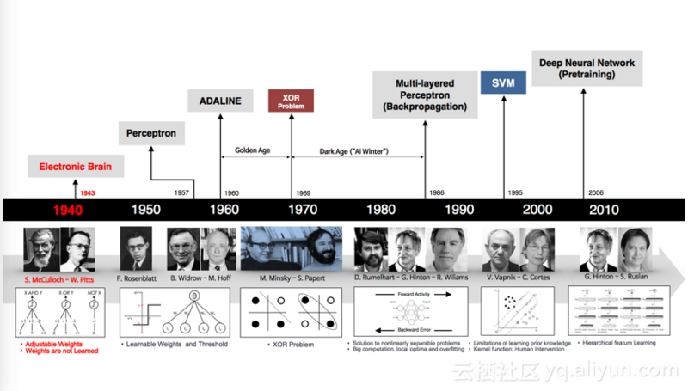
Historical Note

Slide 6
Historical Note
Warren McCulloch and mathematical prodigy Walter Pitts gave McCulloch-Pitts theory of formal neural networks.
In 1949, Donald Hebb further extended the work in this field, when he described how neural pathways are strengthened each time they are used
In 1954, Marvin Minsky presented his thesis “Theory of Neural-Analog Reinforcement Systems and Its Application to the Brain-Model Problem” and also wrote a paper titled “Steps Toward Artificial Intelligence.”

Slide 7
Historical Note
Later John von Neumann invented the von Neumann machine.
1958, Frank Rosenblatt, a neurobiologist, proposed the perceptron, which is believed to be the first physical ANN.
Between 1959 and 1960, Bernard Wildrow and Marcian Hoff developed the Adaptive Linear Elements (ADALINE) and the Multiple Adaptive Linear Elements (MADELINE) models.
In 1986, Rumelhart, Hinton and Williams proposed the back propagation algorithm.

Slide 8
The Biological Neuron
The entire human brain consists of small interconnected processing units called neurons and are connected to each other by nerve fibers
The interneuron information communication makes it possible for multilevel hierarchical information processing, which gives the brain all its problem-solving power.
Each neuron is provided with many inputs, each of which comes from other neurons.
Each neuron takes a weighted average of the various inputs presented to it.
The weighted average is then made to pass over a nonlinear inhibiting function that limits the neuron’s output.
The nonlinearity in biological neurons is provided by the presence of potassium ions within each neuron cell and sodium ions outside the cell membrane.

Slide 9
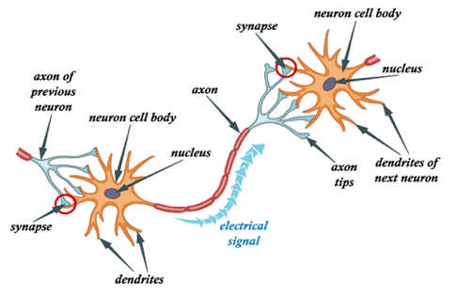
Structural Components of a Neuron
The difference in concentrations of these two elements causes an electrical potential difference, which in turn causes a current to flow from outside the cell to inside the cell. This is how the neuron takes its inputs
A neuron has four main structural components - the dendrites, the cell body, the axon, and the synapse.

Slide 10
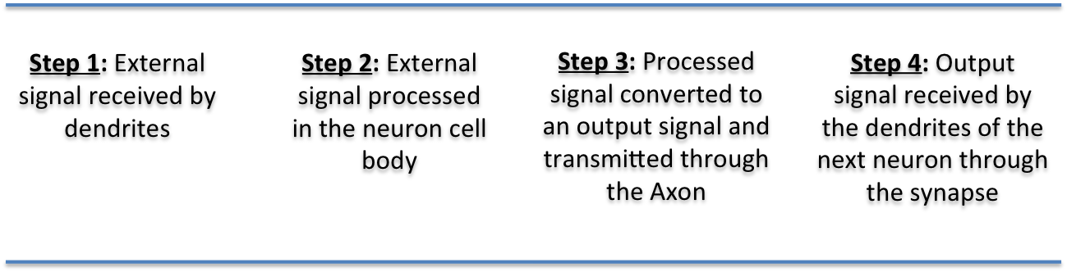
Structural Components of a Neuron
Dendrites are responsible for receiving the signals from other neurons.
These signals are passed through a small, thick fiber called a dendron.
The received signals collected at different dendrites are processed within the cell body, and the resulting signal is transferred through a long fiber called the axon.
At the other end of the axon exists an inhibiting unit called a synapse, which controls the flow of neuronal current from the originating neuron to the receiving dendrites of neighboring neurons.

Slide 11
The Artificial Neuron
The neural network, by its simulating a biological neural network, is a novel computer architecture and a novel algorithmization architecture relative to conventional computers.
It allows using very simple computational operations (additions, multiplication, and fundamental logic elements) to solve complex, mathematically ill-defined problems, nonlinear problems, or stochastic problems.
The artificial neuron is the most basic computational unit of information processing in ANNs.
Each neuron takes information from a set of neurons, processes it, and gives the result to another neuron for further processing.
These neurons are a direct result of the study of the human brain and attempts to imitate the biological neuron.

Slide 12
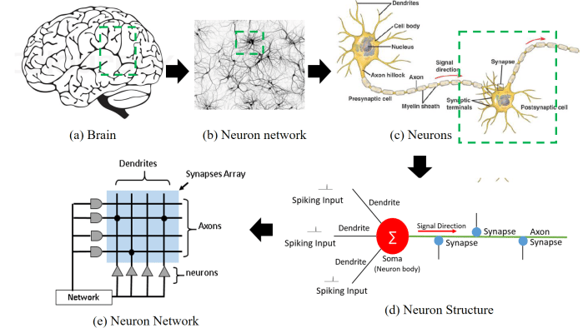
The Artificial Neuron

Slide 13
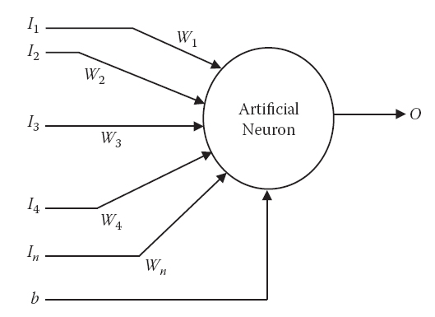
Structure of an Artificial Neuron
The neuron consists of a number of inputs. The information is given as inputs via input connections, each of which has some weight associated with it.
An additional input, known as bias, is given to the artificial neuron.

Slide 14
Biological neural network vs artificial neural network
Relationship between Biological neural network and artificial neural network:
Biological Neural Network | Artificial Neural Network
Dendrites | Inputs
Cell nucleus | Nodes
Synapse | Weights
Axon | Output

Slide 15
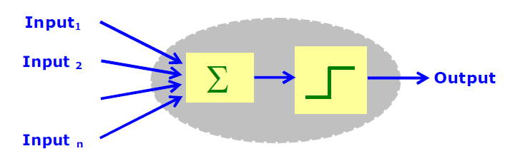
McCulloch-Pitts neuron model
  A set of input connections brings in activations from other neurons.
  A processing unit sums the inputs, and then applies a non-linear activation function (i.e. squashing / transfer / threshold function).
  An output line transmits the result to other neurons.

Slide 16
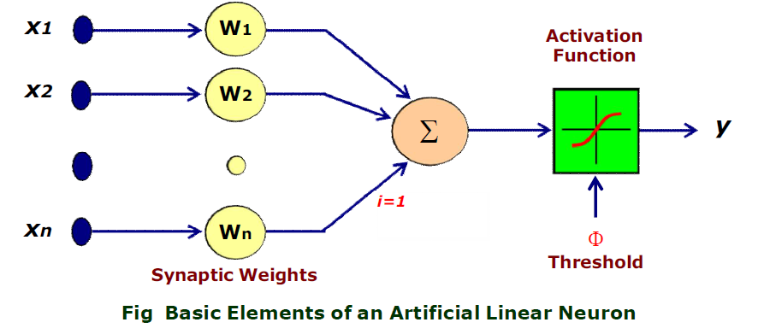
McCulloch-Pitts neuron model
The processing in a single artificial neuron.
the inputs are marked X1, X2, X3, … , Xn; the weights associated with each Connection are given by W1, W2, W3, … , Wn; b denotes the bias; and the output is denoted by O. Because there is one weight for every input, the number of inputs is equal to the number of weights in a neuron.

Slide 17

The Processing of the Neuron
Functionality of neuron that is performed can be broken down into two steps. The first is the weighted summation, and the second is the activation function.
The two steps are applied one after the other, as shown in the previous slide.
The function of the summation block is given by Equation
The summation forms the input to the next block. This is the block of the activation function, where the input is made to pass through a function called the activation function.

Slide 18

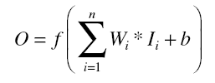
The Activation Function
The activation function performs several important tasks
One of the more important of which is to introduce nonlinearity to the network.
Another important feature of the activation function is its ability to limit the neuron’s output.
The complete mathematical function of the artificial neuron can be given as:
where f is any activation function

Slide 19

12/12/14
CSE510, Lovely Professional University, Phagwara

